Slide 1
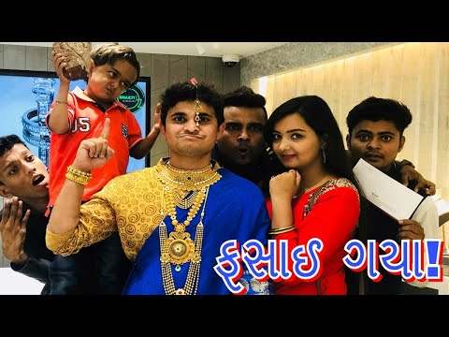
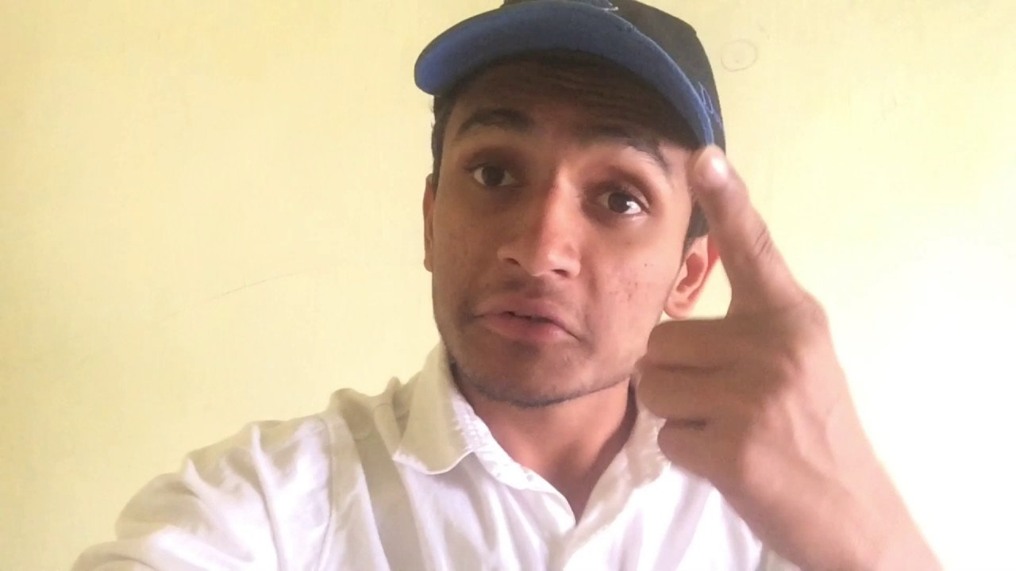
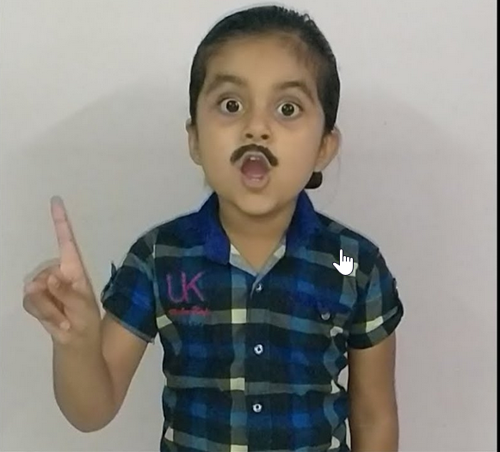
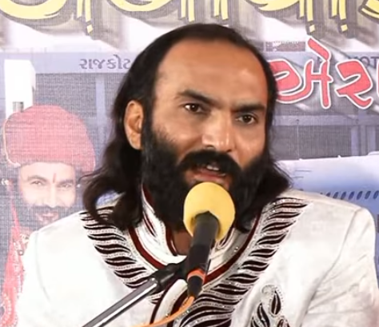

Slide 2

ગુજરાતી HD વિડિઓ
2018

Slide 3

ગુજરાતી HD વિડિઓ
2018

Slide 4

Kinjal Dave Video Songs

Slide 5
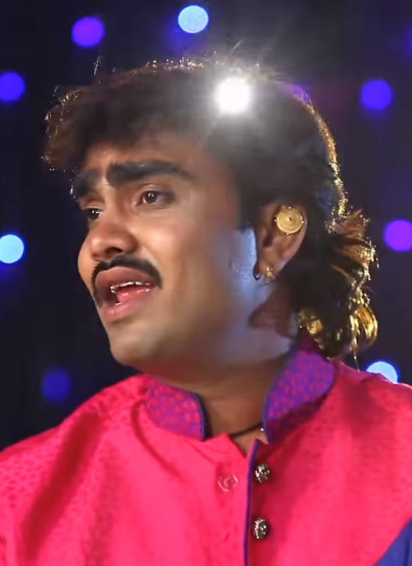
Jignesh Kaviraj Video Songs

Slide 6
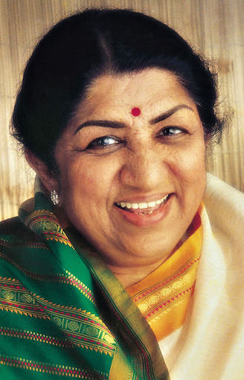
Lata Mangeshkar Old Songs

Slide 7
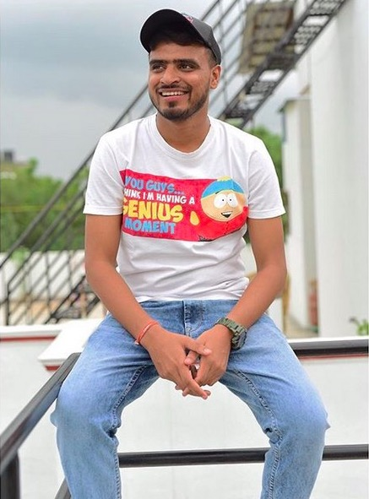

Slide 8
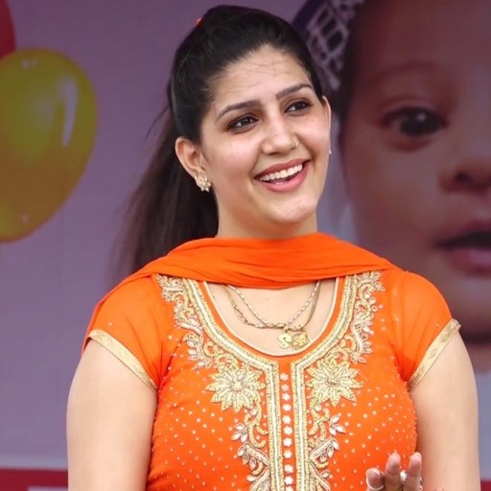

Slide 9


Slide 10


Slide 11

Luccas Neto

Slide 12

Sagar Patel Video Songs

Slide 13

HD VIDEO SONGS 2018
કિંજલ દવે

Slide 14
HD Video
સાગર પટેલ

Slide 16

સાગર પટેલ ની મોજ

Slide 17
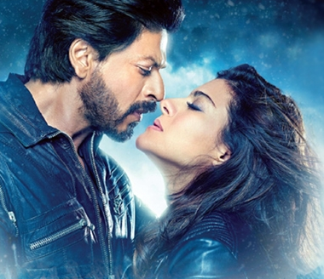
Top Hindi
Songs 2018

Slide 18
Top Hindi
Songs 2018

Slide 19

Top Hindi
Songs 2018

Slide 20
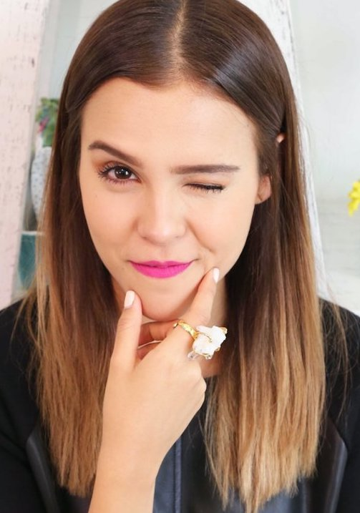
Yuya

Slide 21


Slide 22


Slide 23
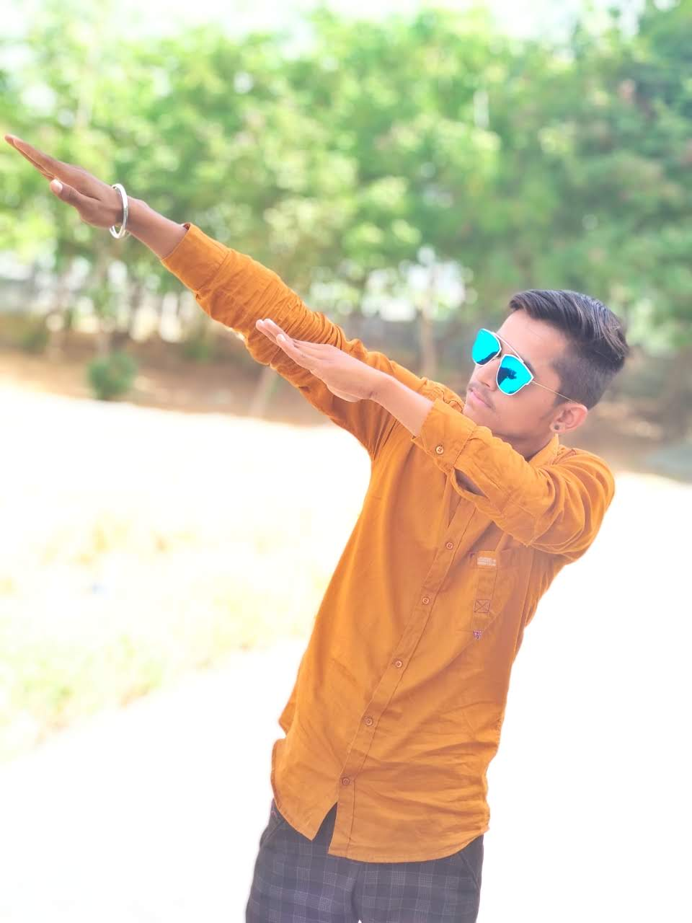
Rutvik Patel – Royal Status

Slide 24
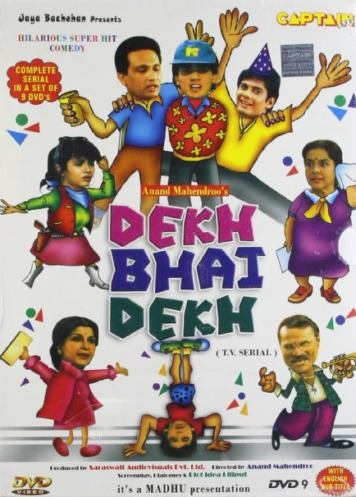

Slide 25
Rutvik Patel – Royal Status

Slide 26
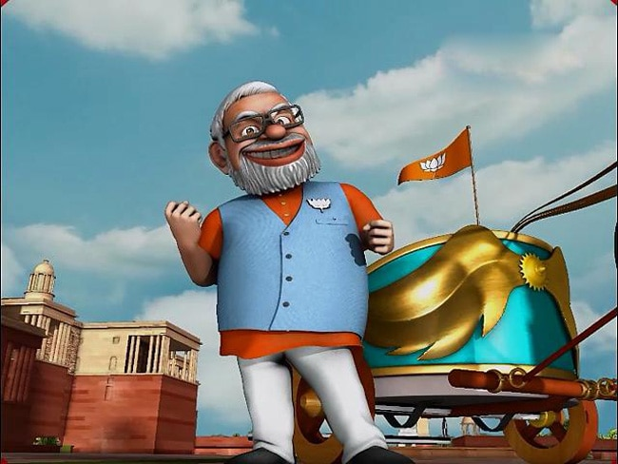
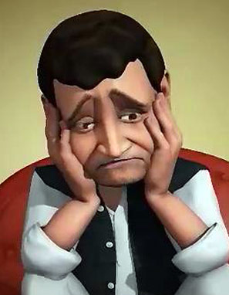
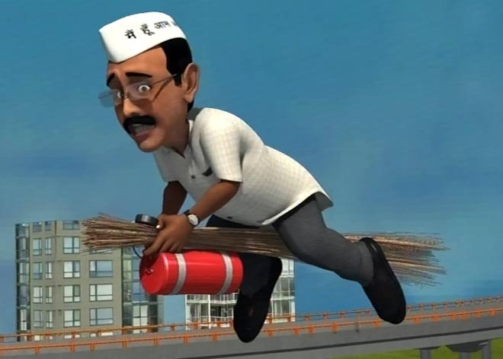
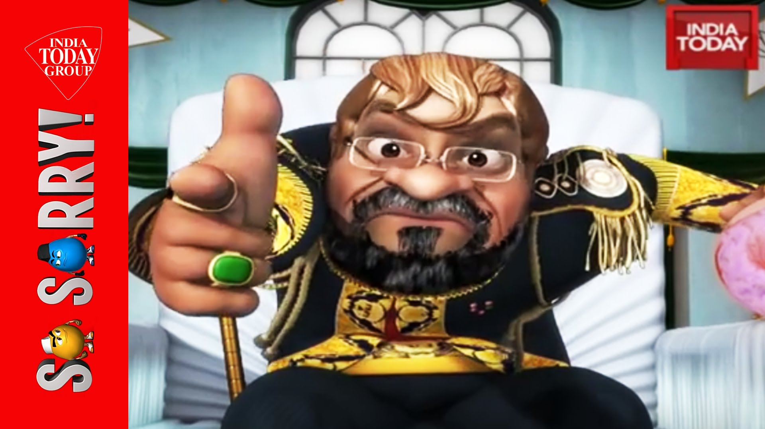
So Sorry

Slide 27

So Sorry Comedy Videos

Slide 28
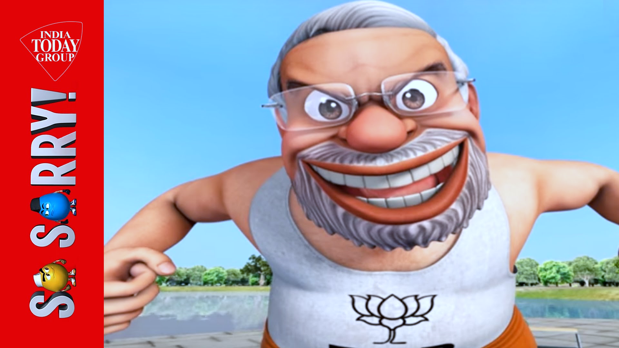


Slide 29
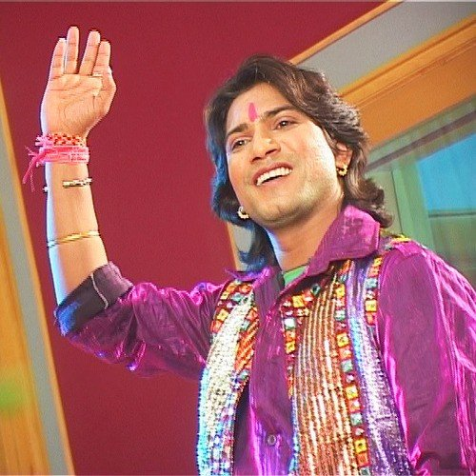
V
T
Vikram Thakor

Slide 30

V
T
Mamta Soni

Slide 32

Haryanvi Comedy Videos

Slide 33
Gujarati HD Videos

Slide 34


Slide 35


Slide 36

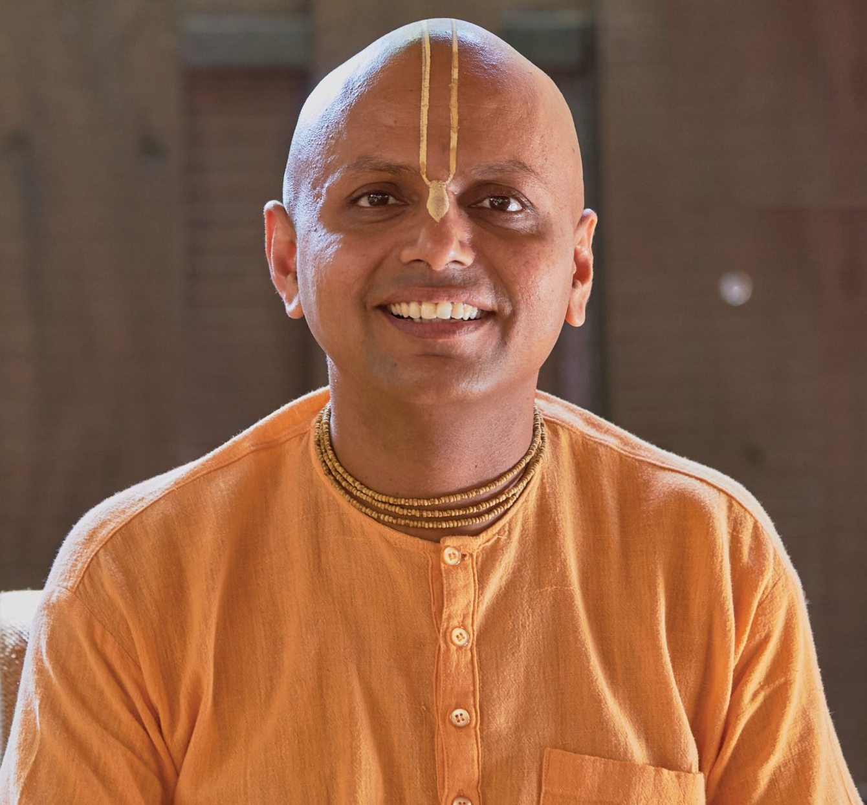

Slide 37


Slide 38


Slide 39

whinderssonnunes

Slide 40


Slide 41
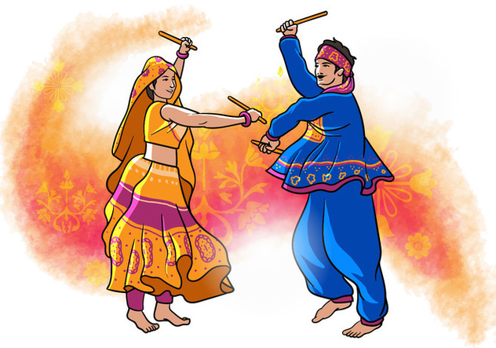
Navratri Garba

Slide 42
Awesome Hindi Videos

